Slide 1
Programme overview and outline
BSc (Hons) Diagnostic Radiography
Validation event – supporting background information
Chris M Alvey

Slide 2
Rationale
The programme has at its heart two key philosophies:
To recruit candidates who are academically capable of undertaking the programme
To produce graduates who are going to be compassionate to patients (in keeping with the NHS Constitution)
Programme supported by University executive
3 year full time undergraduate programme
Successful completion will enable graduates to apply for HCPC registration
Programme has been mapped to HCPC Standards of Proficiency, the Society and College of Radiographers Framework, and QAA benchmark statements
Programme split between clinical and academic blocks
45 week academic year
Notes:
Talk 0.08
Hello Everyone and welcome to De Montfort University
Hopefully you’re all here to listen to me talk a little about Diagnostic Radiography which is a new degree programme that we are launching from September 2019.
This is just one of our healthcare degree programmes taught within the School of Allied Health Sciences and if it’s a professional healthcare degree you’re interested in, I would encourage you to visit the varies stands and related talks to understand which one sounds the most appealing to you.
Successful completion of this particular degree would result in eligibility to register with the Health & Care Professions Council to practice as a ‘diagnostic radiographer’. Like all health care professions that are registered with the HCPC, ‘Diagnostic Radiographer’ is a ‘protected job title’ and you can only apply to works as one if you are on the relevant HCPC register

Slide 3
Competition and future impact
Clear and well documented skills shortage
Our planned intake numbers are intended to add to the local radiographic workforce
Our leavers survey suggests that between 60 and 70% of graduates remain in the local area, which implies that this will go some way to ameliorate the chronic staffing situation within our local NHS Trust.
Cohort (First year intake) | Students
September 2019 | 10
September 2020 | 16 + 2
September 2021 | 16
September 2022 | 16 + 2
Notes:
Talk 0.08
Hello Everyone and welcome to De Montfort University
Hopefully you’re all here to listen to me talk a little about Diagnostic Radiography which is a new degree programme that we are launching from September 2019.
This is just one of our healthcare degree programmes taught within the School of Allied Health Sciences and if it’s a professional healthcare degree you’re interested in, I would encourage you to visit the varies stands and related talks to understand which one sounds the most appealing to you.
Successful completion of this particular degree would result in eligibility to register with the Health & Care Professions Council to practice as a ‘diagnostic radiographer’. Like all health care professions that are registered with the HCPC, ‘Diagnostic Radiographer’ is a ‘protected job title’ and you can only apply to works as one if you are on the relevant HCPC register

Slide 4
Clinical Placement – Practice placement modules
Occurs throughout the three-year programme.
Block placement model alternating with academic theory.
Placement is designed around meeting clinical objectives and providing students with a range of experiences in clinical environments – specifically the HCPC Standards of Proficiency for Radiographers
No minimum hour's requirement, as 100% attendance is expected (policy in place for sickness and absence reporting).
Notes:
Talk 0.08
Hello Everyone and welcome to De Montfort University
Hopefully you’re all here to listen to me talk a little about Diagnostic Radiography which is a new degree programme that we are launching from September 2019.
This is just one of our healthcare degree programmes taught within the School of Allied Health Sciences and if it’s a professional healthcare degree you’re interested in, I would encourage you to visit the varies stands and related talks to understand which one sounds the most appealing to you.
Successful completion of this particular degree would result in eligibility to register with the Health & Care Professions Council to practice as a ‘diagnostic radiographer’. Like all health care professions that are registered with the HCPC, ‘Diagnostic Radiographer’ is a ‘protected job title’ and you can only apply to works as one if you are on the relevant HCPC register

Slide 5
The student (s)

Slide 6
Yearly overview – year 1
Week 1-9 | Week 10-19 | Week 20-25 | Week 26 -33 | Week 34 | Week 35 | Week 36 - 41 | Week 42-51
30/09/2019 - 25/11/2019 | 02/12/2019 03/02/2020 | 10/02/2020 -16/03/2020 | 23/03/2020 - 11/05/2020 | 18/05/2020 | 25/05/ 2020 | 01/06/2020 - 06/07/2020 | 13/07/2020 - 14/09/2020
Academic | Clinical | Academic | Clinical | Exam | Academic | Clinical Year 2 Academic board wk 38 | Holiday
Notes:
Talk 0.08
Hello Everyone and welcome to De Montfort University
Hopefully you’re all here to listen to me talk a little about Diagnostic Radiography which is a new degree programme that we are launching from September 2019.
This is just one of our healthcare degree programmes taught within the School of Allied Health Sciences and if it’s a professional healthcare degree you’re interested in, I would encourage you to visit the varies stands and related talks to understand which one sounds the most appealing to you.
Successful completion of this particular degree would result in eligibility to register with the Health & Care Professions Council to practice as a ‘diagnostic radiographer’. Like all health care professions that are registered with the HCPC, ‘Diagnostic Radiographer’ is a ‘protected job title’ and you can only apply to works as one if you are on the relevant HCPC register

Slide 7
Academic content
Imaging Physics and Technology 1: Scientific principles that underpin the production, recording and display of medical images, the safe operation of radiographic technology, and accessory equipment; key operational and safety aspects of Computed Tomography and Magnetic Resonance Imaging; safe use of ionising radiation in x-ray imaging -broad knowledge base of the Legislation and health and safety surrounding the use of radiation in diagnostic imaging – IRR 17 and IR(ME)R 18
Anatomy & Physiology: Basic structure and function of the skeletal system, commonly encountered pathology, technical evaluation of radiological images for quality; the understanding of the radiographic technique of the Axial & Appendicular Skeleton, students develop preliminary image evaluation skills.
Radiography Axial and Appendicular Skeleton: The radiographic technique used to image both the axial skeleton (chest, abdomen, spine and pelvis) and the appendicular skeleton (upper and lower limbs), essential communication and patient care skills when developing their knowledge of x-ray imaging.
Intro to Healthcare professional: develop the skills required for multidisciplinary team working within the NHS and wider healthcare setting; principles that guide the NHS as well as the six values of the NHS constitution for England. The requirement of healthcare practitioners to demonstrate fundamental professional behaviours are analysed to understand how this translates to both independent practice and working collaboratively as part of a wider team.

Slide 8
Clinical Placement – Practice placement modules
Year 1 | Year 2 | Year 3
DRAD1008 | DRAD2008 | DRAD3008
14 (inc 1 induction) weeks | 23 weeks | 22 weeks
1 +7: 6 (+ 5 weeks as year 2) weeks | (5+)10:3:5 weeks as year 3 | 5+14:3 (elective) weeks
Nominal Total 483 hours | Nominal Total 794 hours | Nominal Total 660 hours
Modules are assessed by two key indices
Clinical skills (series of radiographic examinations, selected to according to students level of experience and academic development)
A series of reflective pieces to evidence the personal and professional development undertaken over the course of the programme – again according to the academic level being assessed.
Notes:
Talk 0.08
Hello Everyone and welcome to De Montfort University
Hopefully you’re all here to listen to me talk a little about Diagnostic Radiography which is a new degree programme that we are launching from September 2019.
This is just one of our healthcare degree programmes taught within the School of Allied Health Sciences and if it’s a professional healthcare degree you’re interested in, I would encourage you to visit the varies stands and related talks to understand which one sounds the most appealing to you.
Successful completion of this particular degree would result in eligibility to register with the Health & Care Professions Council to practice as a ‘diagnostic radiographer’. Like all health care professions that are registered with the HCPC, ‘Diagnostic Radiographer’ is a ‘protected job title’ and you can only apply to works as one if you are on the relevant HCPC register

Slide 9
Support for clinical placement
Students on clinical placement | Staff (clinical whom have a role supporting students)
Mentors (qualified radiographic staff involved in the supervision or assessment of students) to meet weekly to discuss progress or issues. | University led CPD training around the role and support available In line with PEAS framework (SCOR)
Academic staff to meet with students on a monthly basis, to provide guidance and support to students | Tri-partite meeting (monthly) (University/Placement/Student)
Tri-partite meeting (monthly) (University/Placement/Student) | Termly academic forum (Placement / University) - to coincide with University Programme Management Board
 | Annual academic forum (all placement providers / University)
Notes:
Talk 0.08
Hello Everyone and welcome to De Montfort University
Hopefully you’re all here to listen to me talk a little about Diagnostic Radiography which is a new degree programme that we are launching from September 2019.
This is just one of our healthcare degree programmes taught within the School of Allied Health Sciences and if it’s a professional healthcare degree you’re interested in, I would encourage you to visit the varies stands and related talks to understand which one sounds the most appealing to you.
Successful completion of this particular degree would result in eligibility to register with the Health & Care Professions Council to practice as a ‘diagnostic radiographer’. Like all health care professions that are registered with the HCPC, ‘Diagnostic Radiographer’ is a ‘protected job title’ and you can only apply to works as one if you are on the relevant HCPC register

Slide 10
Support for clinical placement
The assessments and documentation
Practice Placement Guide
Clinical Practice Assessment Document
  In three parts
    The Standards of Proficiency – split across 3 years
    Technical skills
    Practical care skills
The Record of Clinical Experience – this is the students record of their development

Slide 11
Support for clinical placement
Assessment of competence
Put simply, is the student able to demonstrate the activity or task to a level that is appropriate for their level of training? It does not need to be a perfect, but should demonstrate the skills necessary for safe and effective care – this should be in conjunction with any development plans or discussions that have led up to this point.
Students need to be able to demonstrate linking theory to practice across all years – your role is key to this in your questioning and discussions with the student

Slide 12
The Standards of Proficiency: Section 1
The HCPC set criteria which the applicant must be able to demonstrate, hence, within the year 3 CPAD, students will demonstrate all of the proficiencies. Year 1 and 2, therefore, should be thought of as continuous assessment.
Within the Year 1 CPAD these competencies are found on pages 13-20
Students should aim to get these signed off by a clinical assessor, who will determine if they are competent in these, according to their level of academic training.

Slide 13
Support for clinical placement
Assessment of competence – technical skills: Section 2
Students should be adding evidence of their experience, which should include a range of radiographic practice areas, in year 1 students are assessed on 5 areas of radiographic practice
Upper limb, lower limb, vertebral column, thorax, abdomen / pelvis (inc hips)
Students are required to pass these practical technical skills

Slide 14
Support for clinical placement
Assessment of competence – practical care skills: Section 3
This section is about the day to day operational aspects of hospital radiographic practice.
It includes mandatory training records, communications, and other aspects related to patient care

Slide 15
The Standards of Proficiency
If students are not deemed competent, then a developmental action plan needs to be completed, which should be retained by the student in their Record of Clinical Experience (RCE)
In the RCE there is the facility to record all discussions and tutorial sessions, as well as the range of clinical practice experience they are exposed to.

Slide 16
So what does clinical supervision look like?
What does assessment look like?
The mentor hub
  http://placementhub.our.dmu.ac.uk/

Slide 17
How do we define competence?
A cluster of related abilities, commitments, knowledge, and skills that enable a person (or an organization) to act effectively in a job or situation.
Competence indicates sufficiency of knowledge and skills that enable someone to act in a wide variety of situations. Because each level of responsibility has its own requirements, competence can occur in any period of a person's life or at any stage of his or her career.
Read more: http://www.businessdictionary.com/definition/competence.html, accessed 28th Jan 2019
the ability to exert control over one’s life, to cope with specific problems effectively, and to make changes to one’s behaviour and one’s environment, as opposed to the mere ability to adjust or adapt to circumstances as they are. https://dictionary.apa.org/competence, accessed 28th Jan 2019
in law, the capacity to comprehend the nature of a transaction and to assume legal responsibility for one’s actions. https://dictionary.apa.org/competence, accessed 28th Jan 2019

Slide 18
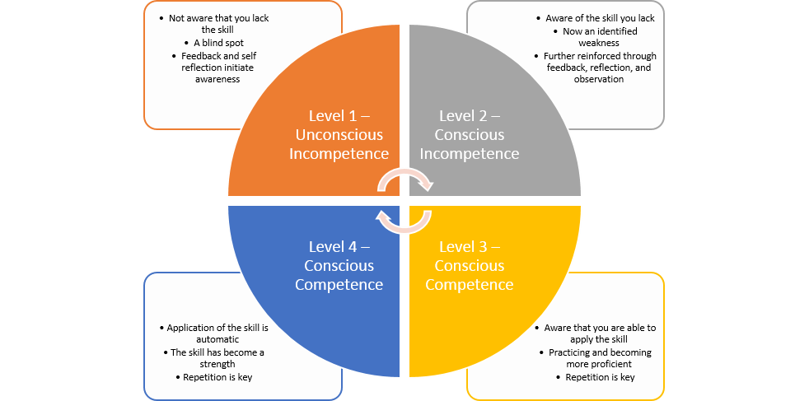
Competence – a four stage approach – Burch
https://higheredrevolution.com/from-ignorance-to-mastery-how-adults-learn-c1d44316e27b, accessed 28th Jan 2019

Slide 19
The four stages
Conscious incompetence, when people are aware of what they don’t know. New students to clinical practice can be overwhelmed by how much they don’t know or understand, which makes them unproductive. Although they sometimes appear uninterested, the students may, in reality, be frustrated by how much they don’t know, as well as the fact that they may not be being effectively trained and have no idea how to reach out for help.
Unconscious incompetence, when people assume that they know something but, in fact, they do not. Ironically, this type of incompetence can set in just as students begin to learn about the role, and the duties and expectations, and how to undertake their role.
Training that consists of cramming as much information as possible is not only ineffective in promoting knowledge retention, but it can also trigger a bigger danger: Having completed the training, students (and experienced employees, as well) may incorrectly believe they truly know the information. Instead, they are unconsciously incompetent, which can lead to serious errors, dissatisfied patients, colleagues, and even safety issues.
https://higheredrevolution.com/from-ignorance-to-mastery-how-adults-learn-c1d44316e27b, accessed 28th Jan 2019

Slide 20
The four stages cntd
Conscious Competence, a person has acquired the skill they set out to learn and can demonstrate it regularly. Their confidence is improving, but it still takes concentration and intention to perform. In this stage, complacency is the enemy. Practice must continue as mistakes will still be made. In fact, trial and error is necessary to keep learning the skill.
Finally, those who have passed through all previous stages reach the fourth and final phase, “Unconscious Competence.” In this stage, application of the skill is automatic, understanding is high, and the skill is now a strength. Those attaining this level of ability must continually seek feedback and guard against regression. Without practice, there is always a risk of falling back to previous stages. Sharing what has been learned with your peers and becoming a mentor is a way to stay sharp and focussed.
https://trainingindustry.com/articles/e-learning/closing-the-competence-gap-preparing-young-professionals-for-the-workforce/, accessed 28th Jan 2019
https://higheredrevolution.com/from-ignorance-to-mastery-how-adults-learn-c1d44316e27b, accessed 28th Jan 2019

Slide 21
Assessment of competence or learning
These three domains of assessment are defined as follows:
Diagnostic assessment – This is completed when a student begins a specific stage of learning (or placement period) and can initially involve a student self-assessment and a SLOT analysis to assess the strengths, limitations, opportunities and threats relating to the student’s current knowledge, skills and attitudes. It can also include initial observations of the student delivering nursing or health care, discussions on areas of practice, and preliminary questioning, in order to give a baseline on which to build and develop action plans and learning strategies.
Formative assessment – This relates to continuous assessment and incorporates regular feedback sessions that are planned throughout the specified time allocated in the learning environment. It gives an opportunity to identify areas of strength and areas that need to be improved, with subsequent action plans developed. It is a method that can be used to monitor progress and provide immediate and ongoing feedback within daily learning experiences. This can also include continuous portfolios of evidence that indicate reflections on learning experiences.
Summative assessment – This is usually a more formal process that is designed to assess specific learning outcomes or criteria at a given point in the student’s learning, usually at the end of a period of study (or placement period). This may be an assignment, examination, objective-structured clinical examination, question and answer discussion, observation, portfolio of evidence, or performance indicators including skills and competencies.
https://www.open.edu/openlearn/ocw/mod/oucontent/view.php?id=20113&section=2, accessed 28th Jan 2019 slides 34-46

Slide 22
Assessment
Prior to assessing learning and competence, the student should engage in some form of self-assessment, either by completing a SLOT analysis or by self-assessing against those criteria required for the practice area. Often it can be assumed that the student will be aware of their own capabilities; however, the process of self-assessment will encourage an opportunity to plan learning. You could discuss with the student their:
1
knowledge base
strengths
limitations
self-perceptions and confidence.
Nevertheless, this process should only be used as one method of assessment in conjunction with others such as direct observation and questioning, which will be needed to confirm current capabilities. Baxter and Norman (2011) suggest that caution is needed when utilising student self-assessment as a method of evidence for competence, as findings from their study recommend this common practice is less than effective and is not an accurate measure of clinical ability when used in isolation. It does however give an insight into how the student perceives their own capabilities and their level of confidence in specific areas of practice.
2

Slide 23
Assessment - Methods of assessment
Direct observation | Does the student need more practice and guidance? Additional role modelling may be required. Does the student appear nervous when being directly observed? Reflect on the impact of your presence and observation technique to ensure these are performed in a supportive way. Clarify when you may need to intervene (i.e. client safety).
Questioning of related evidence-based practice | Does the student understand the underpinning theory relating to the skill or competence performed?
Working alongside the student during an episode of care or placement period | Holistic assessment over a longer period can give context to a required competence. Examples of care settings could include an acute care or community setting. Values and attitudes can be monitored.
Feedback from colleagues, other mentors, service users | Adds to the reliability of decision making and identifies if overall standards of practice have been achieved.
Oral presentation | Must be conducted in a supportive environment. Allows the student time to research and prepare. Can lead to shared learning and new insights.
Reflective discussion/writing | Promotes self-awareness and encourages critical analysis of episodes of care. Helps to demonstrate knowledge learned, what went well and what could be done differently in future care interventions.
Problem-based scenarios or patient stories | This method can be useful to discuss possible scenarios that have not been observed. These can determine a student’s understanding and application of radiographic knowledge to a variety of situations and must include holistic care of people with disabilities and learning needs, including visual and hearing difficulties that may not be physically obvious.

Slide 24
Assessment
When completing assessment documentation, you are accountable for the decisions you make. Therefore, you should be detailed, systematic and comprehensive in collating the evidence that is required to inform your judgement. When assessing student competencies, there may be just a signature box to complete within the assessment document, an identified space to write a rationale for a decision or a general comment box following a set of competencies within a specific learning domain. These spaces should always be utilised fully to justify the decision you make.
Assessment can be seen to be interpretive and somewhat subjective, so drawing on appropriate evidence when writing your comments can lead to increased confidence in your assessment. This can be discussed openly and honestly with the student. Price (2012) suggests that there should be no surprises for the student when it comes to the final placement interview if effective continual assessment (including regular discussions and constructive feedback) has been implemented.
Remember that assessment must be against a set of criteria, and not against another student's performance

Slide 25
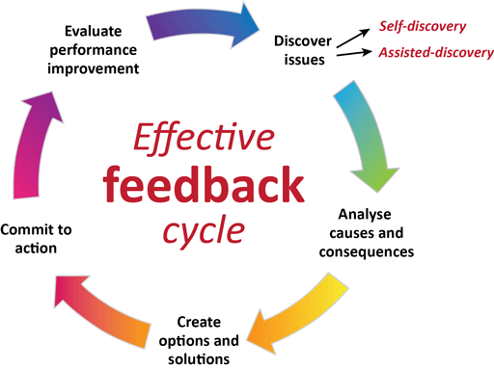
Feedback
In the clinical placement documentation there are specific models of feedback suggested, you are free to use these, or others; for example
‘How did you feel about that care episode today?’
Allow the student time to express their views and reflect on the care scenario, incorporating these points into your feedback as appropriate.
‘I felt the care you gave to Mr S was good, as you demonstrated care and compassion and maintained his dignity throughout. There are a few things that you could try to incorporate next time in order to improve your care. You did introduce yourself and explained the procedure you were about to perform, but you could explain this further in terms that Mr S would understand, as you did use some medical terms. You also need to check a patient’s understanding and give them time to ask any questions before commencing the procedure. I was really pleased to see you ensured that Mr S was comfortable before leaving and asked him if he needed anything. How do you feel about the feedback I’ve given you …?’
Allow the student time to ask for clarification from the points you have raised and any differences of opinion. Be prepared to justify your assessment of the situation and feedback given. Be open to learn about your own feedback mechanisms and encourage the student to give feedback to you.
‘So, if you’re happy to move forward we can now agree some action points from this discussion to give you direction in how to develop your care.’

Slide 26
Support for the failing student
We have looked specifically at the processes of assessment and how to deliver constructive feedback in the practice setting. You also explored various methods of assessment and considered feedback strategies. The aim now is to discuss the strategies and skills that will help you to identify the student who is either failing or has failed and provide the appropriate opportunities and support for them to meet the required competencies in order to successfully complete their placement.
Most students of radiography achieve their required competencies in practice. However, there are a few whose performance may be considered weak and who have trouble in meeting the required standards. It will be necessary to provide extra support and supervision for these students. Duffy’s (2003) study is a significant piece of research that has contributed to the literature on reasons why mentors lack confidence in failing students, with more recent research replicating many of Duffy’s original findings. For example, a later study by Gainsbury (2010) found that a quarter of interviewees felt unconfident in managing students’ performance. Further evidence (Brown et al., 2012; Heaslip and Scammell, 2012) suggests that mentors find this aspect of their role most challenging and are reluctant to fail students when they do not perform as expected. This may occur because the student may display behaviours that can be hard to identify (Duffy, 2004; Skingley et al., 2007; Black et al., 2014). In this context, as a mentor you need to work closely with students to provide support or opportunities as required

Slide 27
Recognition of the failing student
Duffy and Hardicre (2007b) and Black et al. (2013) list a range of issues that suggest why learners fail to engage with practice. You may have noted similar issues from your reflection and discussion with others. These include:
  a lack of insight, poor self-awareness and unresponsiveness to feedback
  a lack of interest, motivation, enthusiasm or commitment – not asking questions, poor communication or interpersonal/interactional skills – insensitive interaction with patients
  frequently late or absent, exhibit poor preparation and organisational skills
  preoccupation with personal issues – poor health, withdrawn, sad and tired
  poor professional behaviour/boundary issues, either overconfident or underconfident
  lack of theoretical knowledge and skill, and provides limited evidence to support their learning
  avoidance of working with the mentor and changing shifts
  unsafe practice and poor judgement.
It is important to raise and document your concerns regarding underperformance at the earliest opportunity and not to ignore problems as they occur. Evidence suggests that if you take time to explore the issues early and put an action plan into place, this may enable the learner to rescue what may originally be considered a failing situation (Duffy and Hardicre, 2007a).

Slide 28
Breaking bad news – failing a student
Breaking bad news is never an easy option, so informing a student near the end of their programme of study that they have failed their placement will naturally upset the individual. Walsh (2014) explains how students may react to the outcome of assessment with a feelings which may include:
  denial – they respond with disbelief and shock to a failed assessment
  betrayal – they may feel hurt that their ‘friend’ has failed them sadness – some will cry, which can be upsetting for the mentor
  relief – some students may be relieved and willing to accept a failed assessment. In some instance's failure can have a positive outcome.
Support is crucial for students who perceive this as a stressful experience. An opportunity should be provided for them to repeat the experience when appropriate, and to have access to a range of support services from the HEI, linked lecturers, module leaders, counselling and student union processes.
It will depend though on the University policy for repeating clinical placement / assessment

Slide 29
Breaking bad news cntd
This can be an equally stressful experience for the mentor, who will require support. Managing the process of underachieving or failing students must be made with confidence (Brown et al., 2012). A decision to fail a student nearing the end of the programme can be a challenge, because the underperformance should have been addressed earlier. your decision could cause tensions within the team or the organisation if it is perceived that some of the mentors assessing students on their previous placements did not fulfil their assessment obligations. However, failing to fail students can have serious consequences for the service users, who may be put at risk.
Unfortunately some students will attempt to use coercive techniques to manipulate a mentor/assessment decision, Hunt et al (2016) outlines these, and some techniques to avoid them:
  Ingratiators – deliberately charming, indulging, or emotionally exploitative
  Diverters – students attempt to distract or redirect the mentors focus by exaggerating the effects of external processes
  Disparagers – students whom challenge the mentor in belittling, denigrating, or professionally harmful ways; accusing the mentor of bullying, harassment, and intimidation.
  Aggressors – students whom demonstrate open hostility towards their mentor after receiving negative feedback or bad news, either verbally or physically; or via third party.
Mentors require support and guidance when they fail students, because they must deliver difficult messages to the underperforming student. They need to develop confidence and must be clear about the roles and responsibilities in making these decisions.

Slide 30
Breaking bad news cntd.
Mentors need to familiarise themselves with students’ documentation and assessment regulations and must keep accurate records to support and justify their decisions on whether a student is competent or not.
They need to demonstrate that they have provided regular feedback and kept a record of this while mentoring students (Walsh, 2014). They can then make valid assessments on whether a student is competent or not.
In practice, the consequences of not failing students are that we fail in our duty of care to protect the safety of those whom we serve.

Slide 31
Education audit
Your role in evaluating practice learning in your area will include some involvement with educational audit. This is a process that is required by the regulating body (the HCPC) to assure standards are met in relation to student learning in practice.
Education providers are responsible for organising and completing bi-annual audits of all placement areas used for student clinical placements. This is done in partnership with placement providers and will involve link tutors, clinical education leads and facilitators, healthcare managers, practice teachers, mentors, and students.
Each education provider will have its own format, criteria, and audit process, so it is important that you are familiar with these and have sight of the most current audit for your practice area, what are the areas of good practice, and what needs improving. In some areas of the UK, higher education institutes will work together to share educational audit assessment.

Slide 32
Peer review
You may have been involved in peer review as part of educational processes relating to assessment, or as part of an appraisal process such as 360-degree feedback from colleagues.
There are more tools available on the NHS Leadership Academy website You may also relate peer review to the role of a ‘critical friend’ who has the expertise to give constructive feedback on your performance.
As part of your continuing development as a mentor, it is important to seek feedback on your own mentorship practices and also contribute to mentor colleagues’ development. This can be both informal and formal depending on your practice areas’ guidance and requirements.
However, the process of peer review can encourage and support mentors in continuous improvement. Peer review should involve those of the same status or role, which in this context are your fellow mentors.
Peer review should not be seen as a ‘pass’ or ‘fail’ activity but should be seen as providing constructive feedback on performance and discussing areas for improvement. This is similar to the constructive feedback processes discussed earlier.
Peer review, when conducted effectively, also helps to build confidence in the person being ‘reviewed’ and ultimately embeds a culture of mentorship excellence in the ‘reviewer’ feeding back to colleagues.

Slide 33
Scope, frequency and content of student discussions
Within the CPAD there is a template for student discussions, and a model of an action plan pro-forma.
We suggest a weekly meeting with the student to review progress against aims for the particular week.
Each month academic link tutors will visit the students on clinical placement and seek to have a conversation with clinical staff involved with student education.
There will, in addition, meetings with the both the student and practice education team.
The structure of these discussions is intended to be a constructive positive experience for all concerned, and clinical staff are encouraged to reflect on the line, style, and phraseology used when exploring students understanding of a particular area, issue, or technique.
Staff should also be mindful of the stage of student training, and their academic course content.

Slide 34
Scope, frequency and content of student discussions
We would consider it good practice, during the initial meeting, that the scope and nature of discussions is outlined.
This could include an outline of expectations from both parties (i.e. the student and practice educator)
It may require a formal 'learning contract'
It should also state what the limits of confidentiality are including disclosure
Clinical staff should have a clear view of the processes of assessment, and of the fitness to practice / concerns procedures
Clinical staff should have confidence in the processes and procedures for student discipline within the academic setting

Slide 35
Effective questioning?
Underpinning all the assessment methods explored previously is effective questioning, which helps to:
understand the students’ thought processes
assess students’ critical thinking skills and decision-making capabilities
clarify the processes and actions observed
ascertain understanding of the various components of a care intervention
encourage further reflection.
Carlson et al. (2009) suggest that questioning is the most commonly used form of student–mentor interaction, should be planned carefully in relation to the student’s stage of learning and should not be interrogative or judgmental. Ness (2010, p. 42) identifies key points below when asking students in practice questions to assess their learning:
Do my questions relate to the students learning outcomes?
Are my questions clear?
Do my questions help the student link theory to practice?
Are my questions at the appropriate academic level for the student?
Are my questions seen as threatening?
Am I asking too many questions at once?
Am I asking questions in an appropriate place?
Am I asking questions at an appropriate time?
Do I listen to the student’s response?

Slide 36
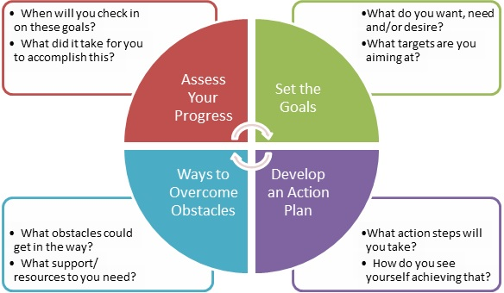
Coaching and Mentoring – supporting the student

Slide 37
Goals – where do you see yourself, what do you want to do?
What is the reality of the situation?
What are the opportunities available to achieve these goals?
When are you going to do this? – How likely are you to do this?
How will you monitor your progress?

Slide 38
Coaching and mentoring
Coaching:
Is task oriented. The focus is on concrete issues, such as managing more effectively, speaking more articulately, and learning how to think strategically. This requires a content expert (coach) who can teach the coachee how to develop these skills.
Is short term. A coach can successfully be involved with a coachee for a short period of time, maybe even just a few sessions. The coaching lasts for as long as is needed, depending on the purpose of the coaching relationship.
Is performance driven. The purpose of coaching is to improve the individual's performance on the job. This involves either enhancing current skills or acquiring new skills. Once the coachee successfully acquires the skills, the coach is no longer needed.
does not require design. Coaching can be conducted almost immediately on any given topic.
In coaching, the coachee's immediate manager is a critical partner. She or he often provides the coach with feedback on areas in which his or her employee needs coaching. This coach uses this information to guide the coaching process

Slide 39
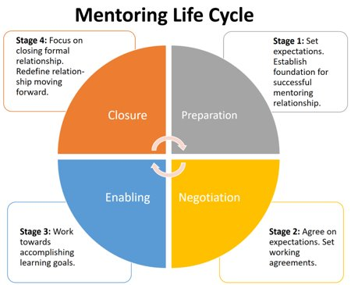
Coaching and mentoring – supporting the student

Slide 40
Coaching and mentoring
Mentoring:
Is relationship oriented. It seeks to provide a safe environment where the mentee shares whatever issues affect their professional and personal success. Although specific learning goals or competencies may be used as a basis for creating the relationship, its focus goes beyond these areas to include things, such as work/life balance, self-confidence, self-perception, and how the personal influences the professional.
Is always long term. Mentoring, to be successful, requires time in which both partners can learn about one another and build a climate of trust that creates an environment in which the mentee can feel secure in sharing the real issues that impact their success. Successful mentoring relationships last nine months to a year.
Is development driven.Its purpose is to develop the individual not only for the current job, but also for the future. This distinction differentiates the role of the immediate manager and that of the mentor. It also reduces the possibility of creating conflict between the employee's manager and the mentor.
requires a design phase in order to determine the strategic purpose for mentoring, the focus areas of the relationship, the specific mentoring models, and the specific components that will guide the relationship, especially the matching process.
the immediate manager is indirectly involved. Although they may offer suggestions to the employee on how to best use the mentoring experience , the manager has no link to the mentor, and they do not communicate at all during the mentoring relationship. This helps maintain the mentoring relationship's integrity.

